Slide 1
CQRS & EventSourcing In an Xamarin App

Slide 2
Agenda
CQRS
Event Sourcing
StateStores
MVVM
CQRS & ES with Xamarin and Prism

Slide 3
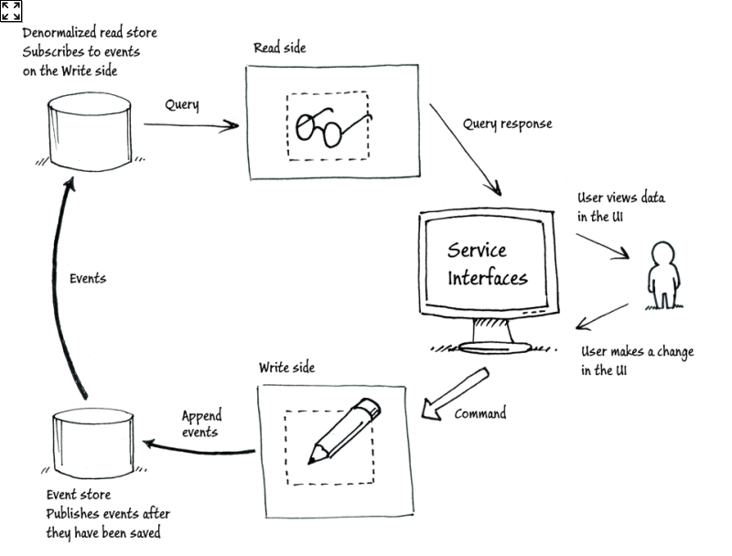
Command and Query Responsibility Segregation

Slide 4
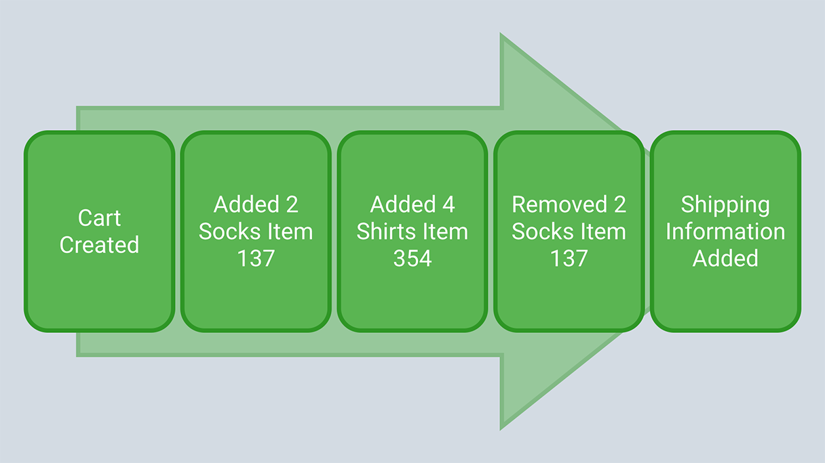
Event sourcing

Slide 5
Modern App development
CQRS and StateStores
  Flux
  Redux
  Elm

Slide 6
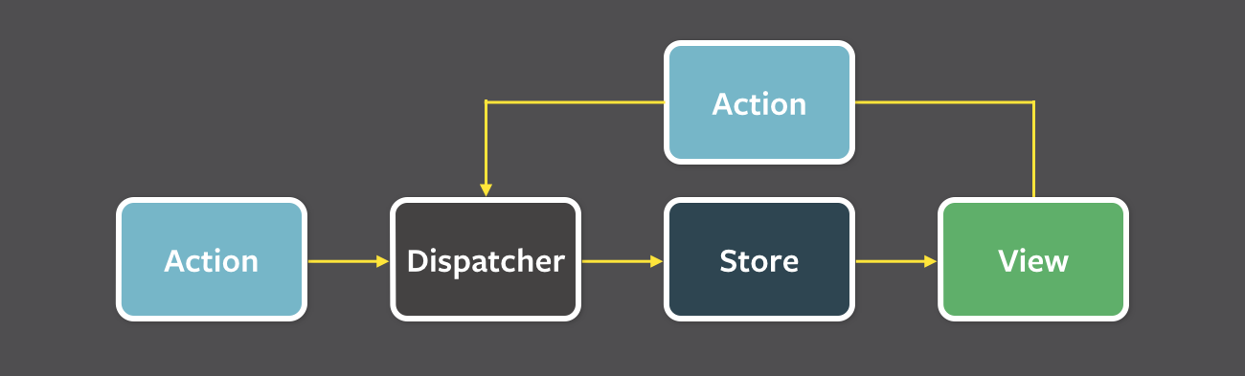
Flux

Slide 7
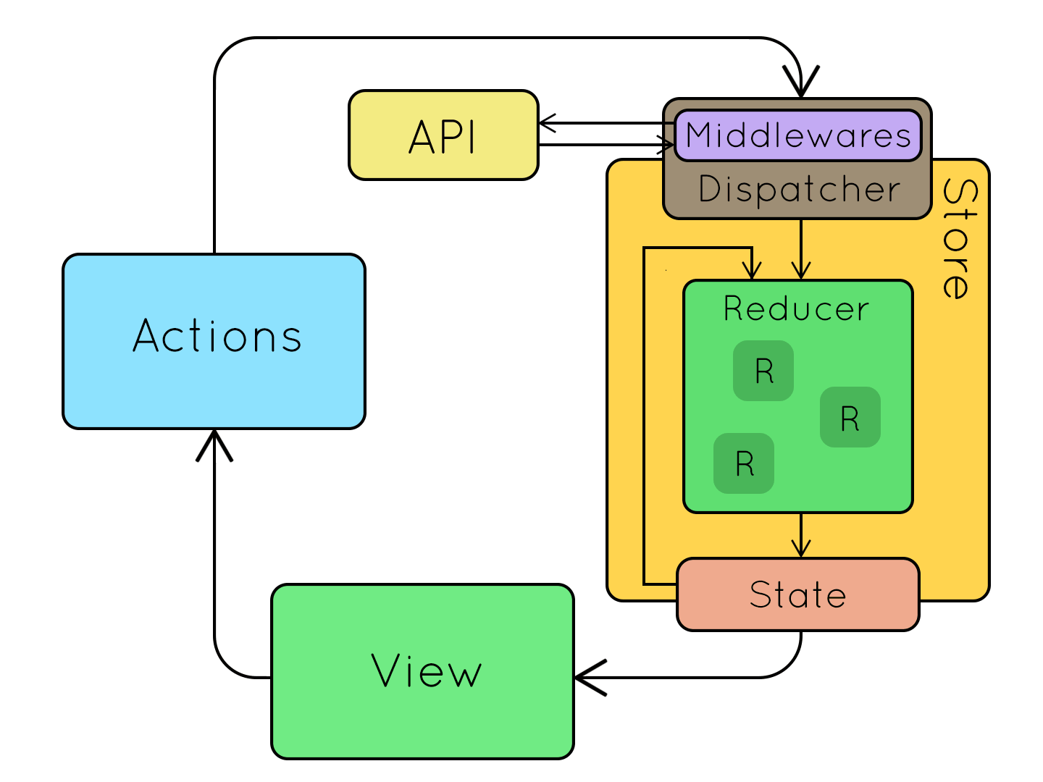
Redux

Slide 8
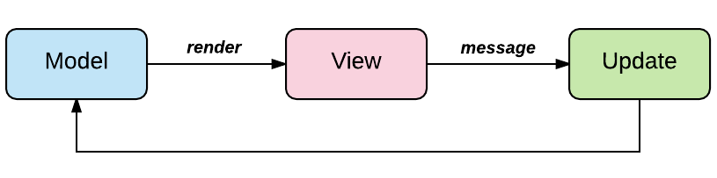
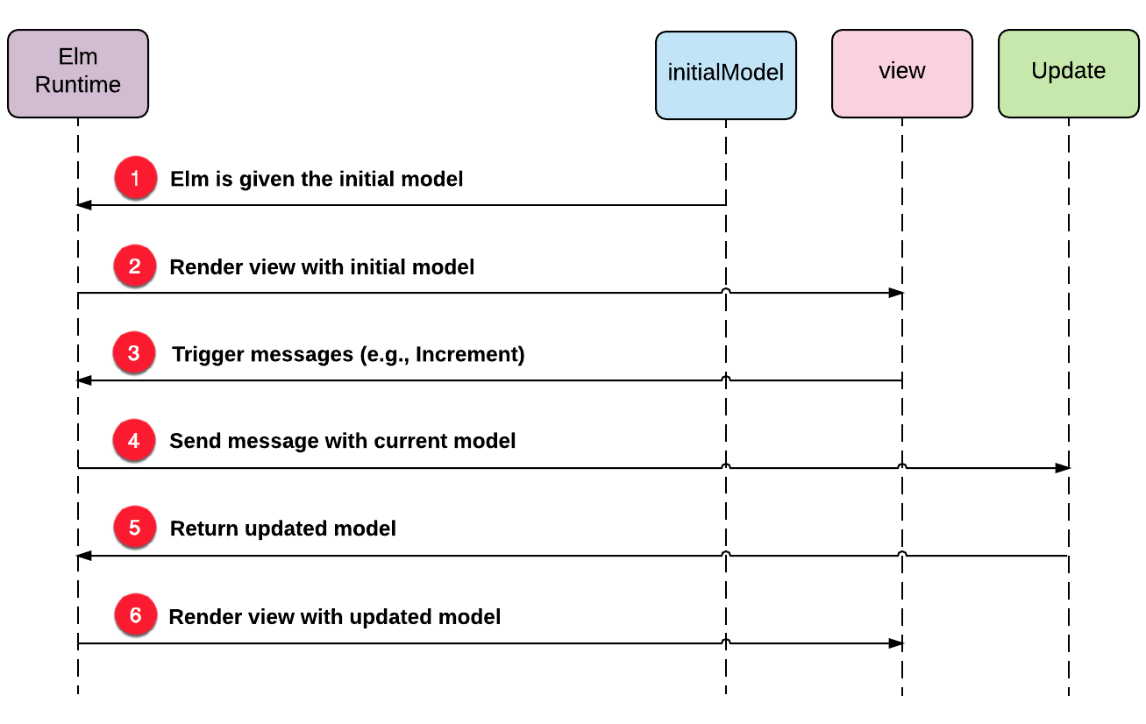
Elm

Slide 9
Event Sourcing & CQRS

Slide 10
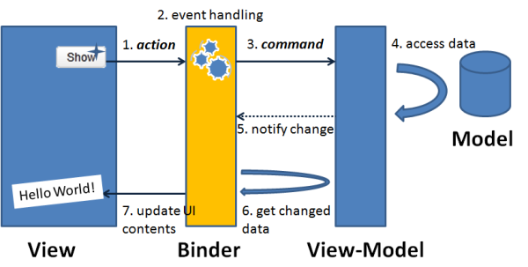
MVVM
Model - view - ViewModel

Slide 11
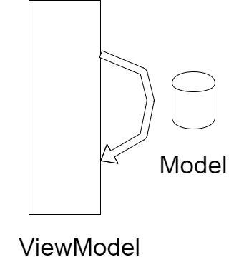
Hook into Model – ViewModel connection

Slide 12
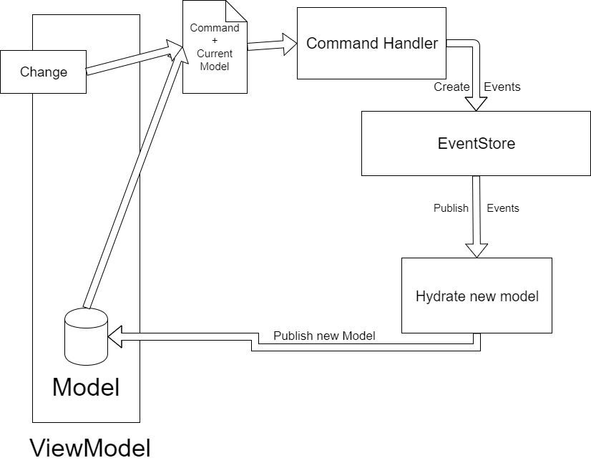
CQRS and EventSourcing

Slide 13
Demo

Slide 14
Thank you
Flux: https://facebook.github.io/flux/docs/overview.html
Redux: https://redux.js.org/
Elm: https://guide.elm-lang.org/architecture/
MVVM: https://en.wikipedia.org/wiki/Model%E2%80%93view%E2%80%93viewmodel

